Slide 1
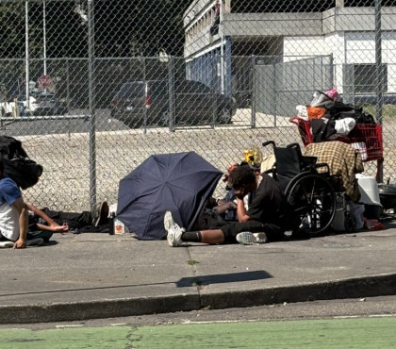
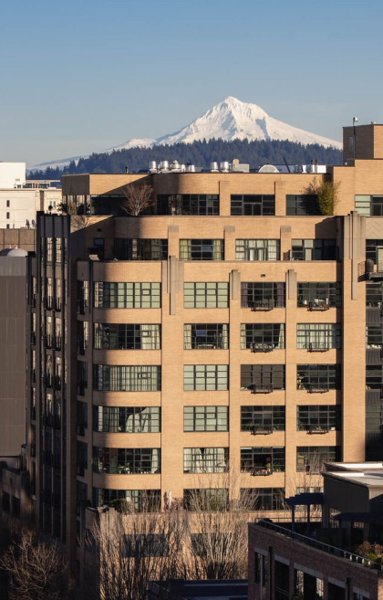
Issues of Livability and Safety around Shelters in the Pearl
How we got here, and the priorities for turning this dire situation around
Notes:
---
This presentation examines the proposed shelter at NW Northrup, presenting data-driven opposition and outlining alternative solutions. We'll explore policy failures, well-researched critiques of current plans, and the impact of shelters on surrounding neighborhoods.
Image source: Microsoft 365 content library

Slide 2
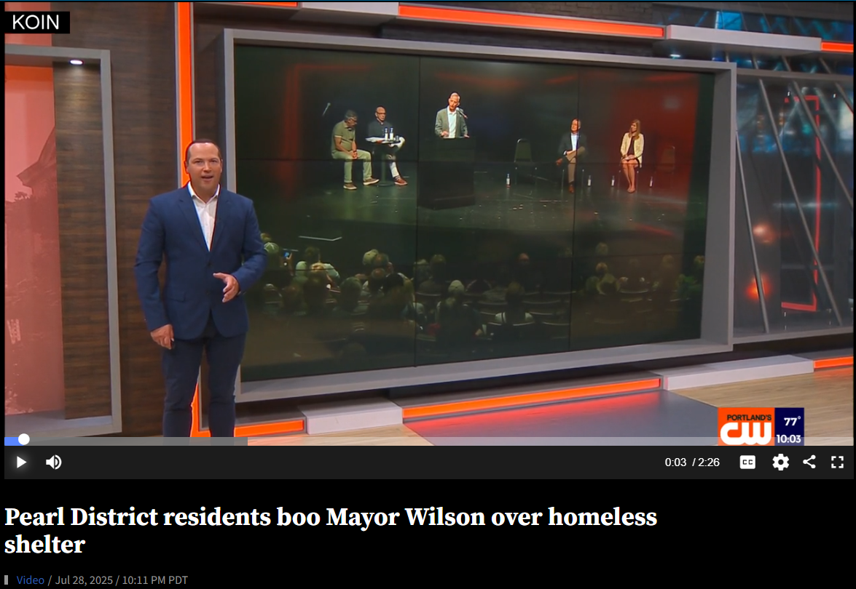
Pearl District residents boo Mayor Wilson over homeless shelter
July 28, 2025
Notes:
---
The Pearl District has undergone significant transformation from its industrial roots to a vibrant urban neighborhood. This development has not only changed the landscape but also created challenges in addressing homelessness and social issues.
Image source: Microsoft 365 content library

Slide 3
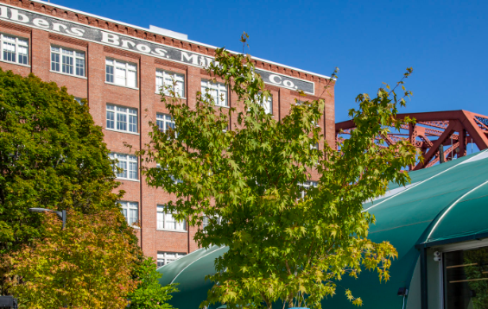
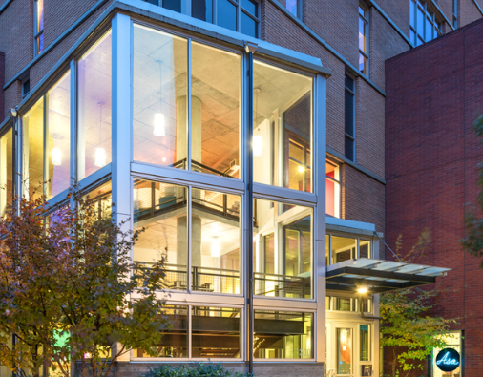
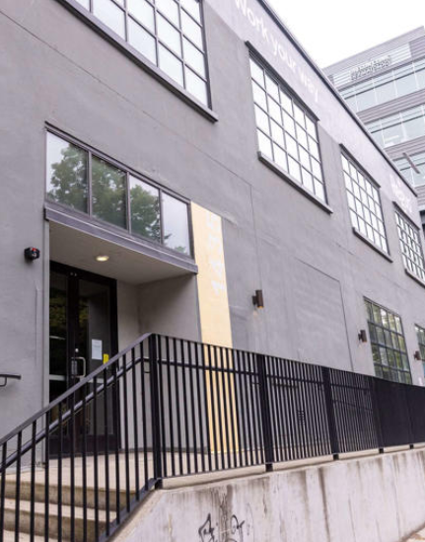
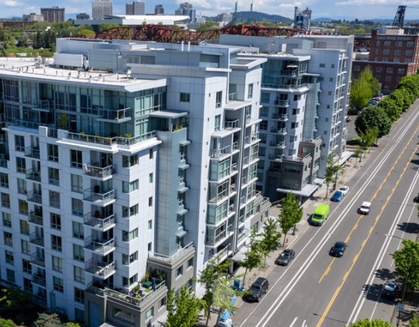
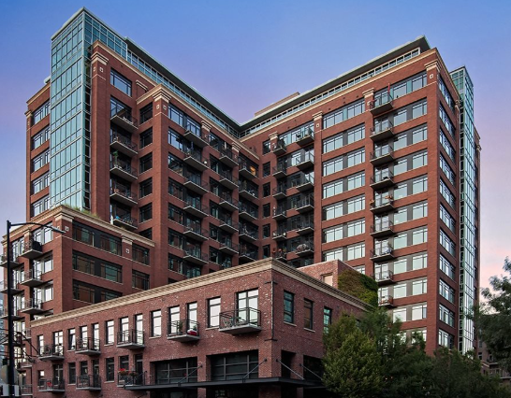
The Northrup Shelter and River District Navigation Shelter were placed in very densely populated urban neighborhoods, where they have led to a dramatic increase in livability and safety issues.
Notes:
---
The Pearl District has undergone significant transformation from its industrial roots to a vibrant urban neighborhood. This development has not only changed the landscape but also created challenges in addressing homelessness and social issues.
Image source: Microsoft 365 content library

Slide 4
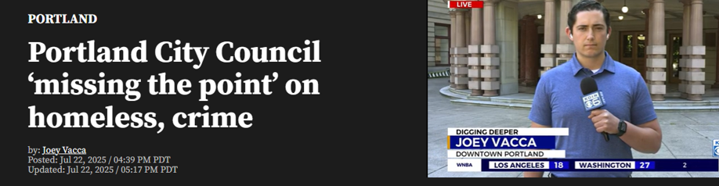
Research shows that the denser the population in a residential and business district, the greater the negative impact of homeless services on safety and livability. Those effects can NOT be mitigated.
It’s simple: Homeless services attract larger homeless populations and other activities (drugs) which have a direct correlation to increased property crimes, person crimes and social crimes.
Notes:
---
The Pearl District has undergone significant transformation from its industrial roots to a vibrant urban neighborhood. This development has not only changed the landscape but also created challenges in addressing homelessness and social issues.
Image source: Microsoft 365 content library

Slide 5

Those effects can NOT be mitigated.
There are not enough police or private security in the city to enforce the law.
There are state laws that cripple the Time-Place-Manner regulations.
That are state laws that prohibit cities from rapidly removing encampments.
The county does essentially nothing in response to street-level mental illness and acute drug use.
A significant number of city council members doesn’t feel these safety and livability issues are important to address.

Slide 6
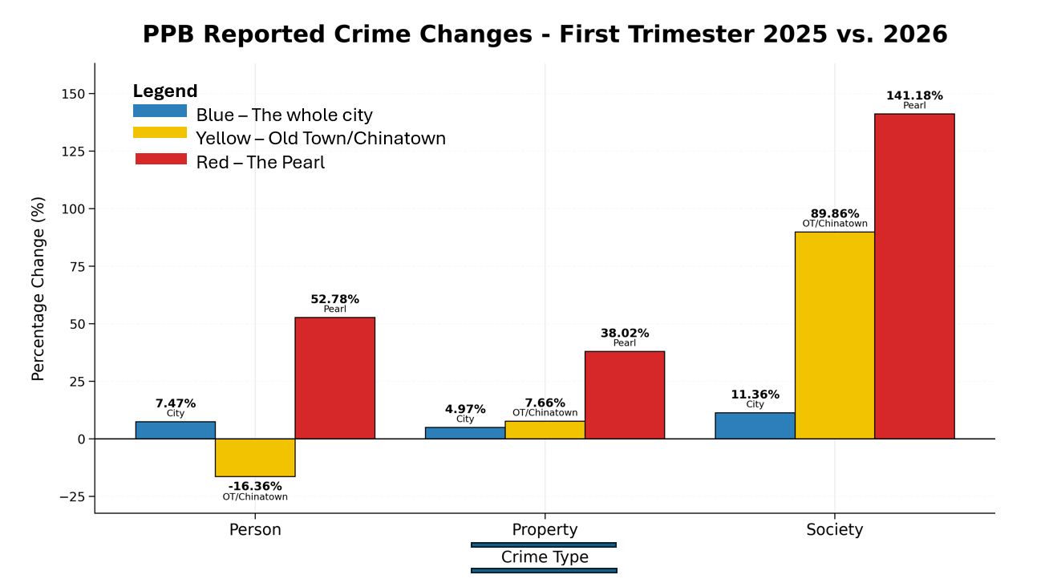

Slide 7
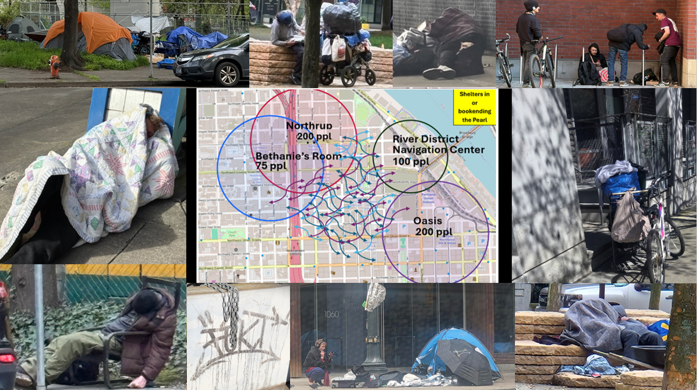

Slide 8
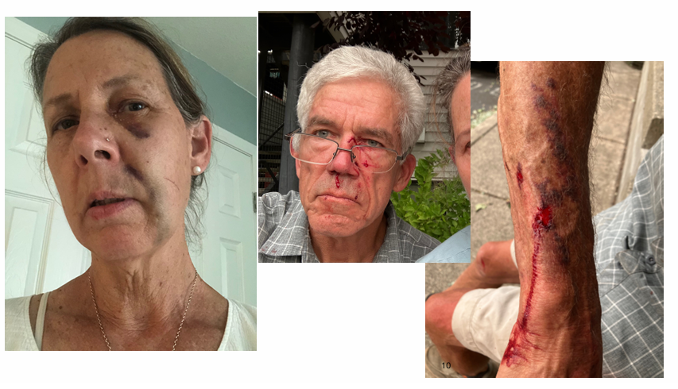
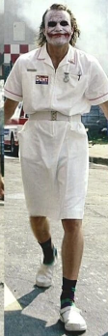
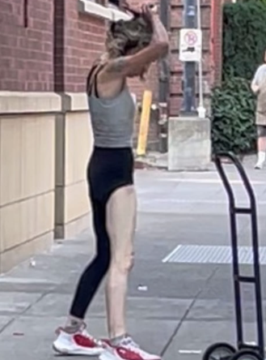
Examples of Crime Against People in the Pearl
VICTIMS
RECENT PERPETRATORS

Slide 9
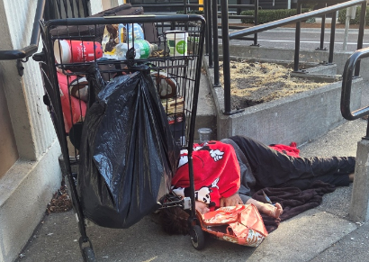
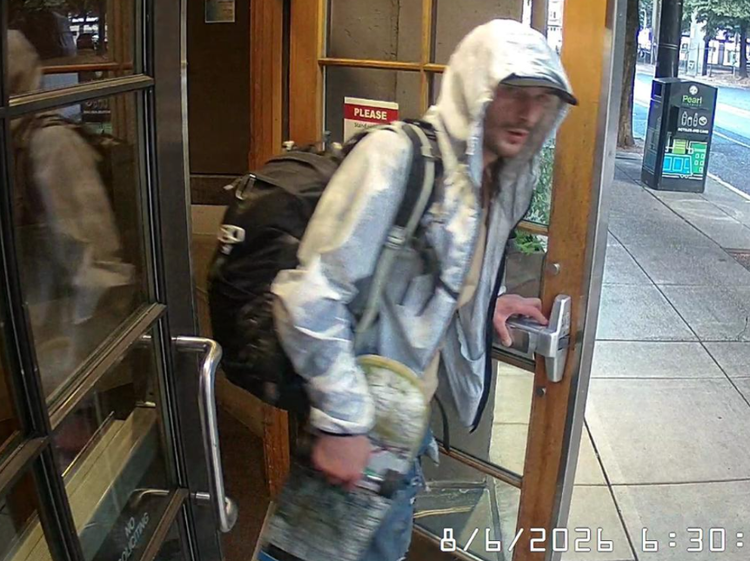
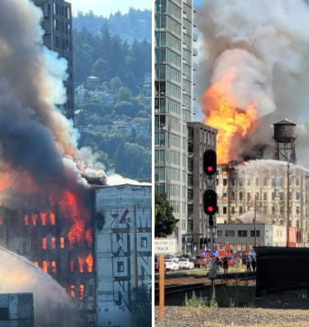

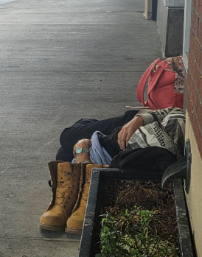
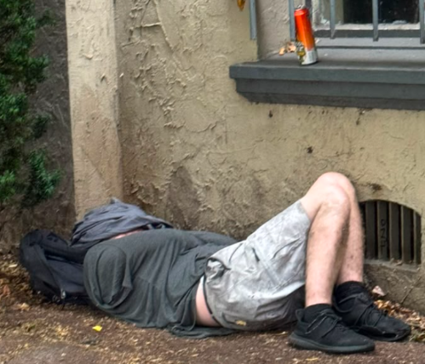

What Does Property Crime Look Like?
Increased property crime in the Pearl:

Slide 10
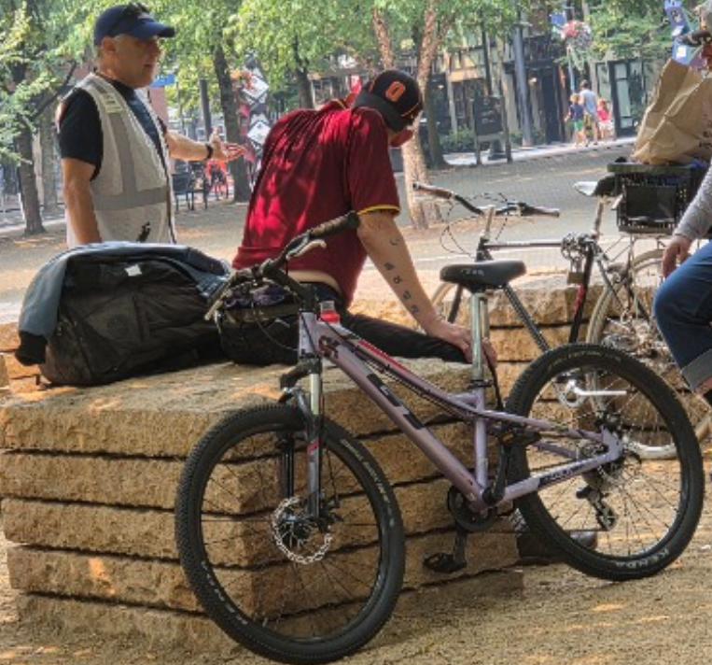
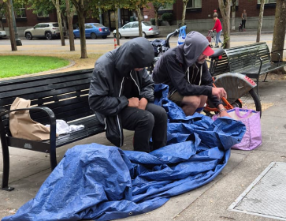
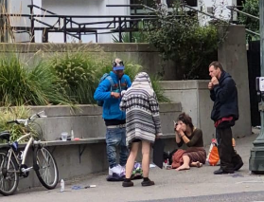
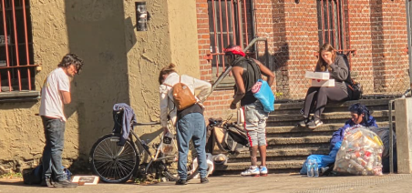
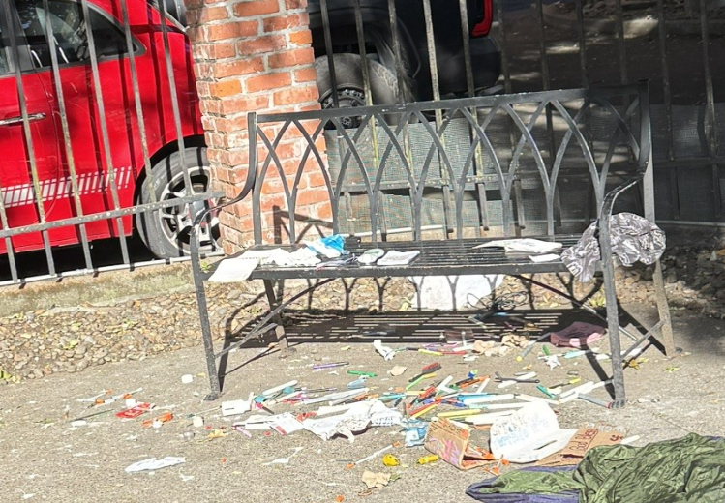
What Does Social Crime Look Like?
Increased social crime (drugs, prostitution, etc.)

Slide 11
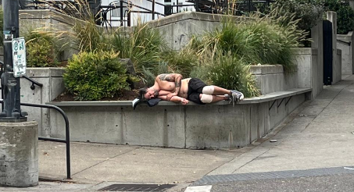
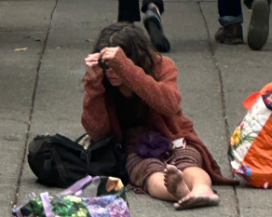
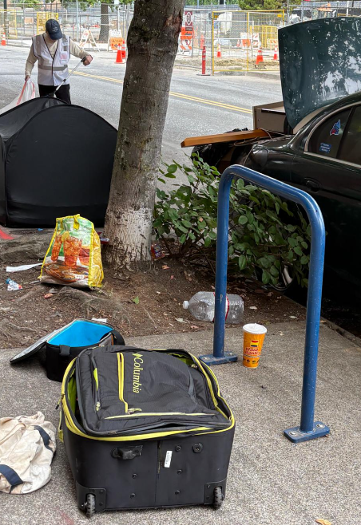
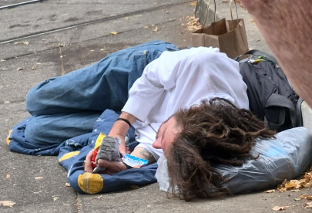
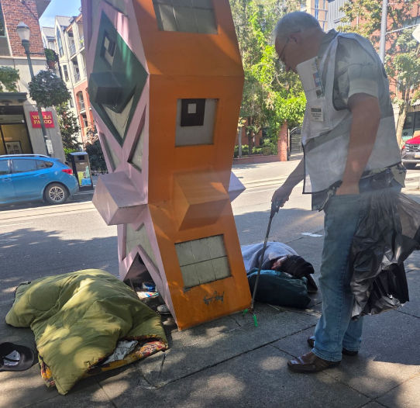
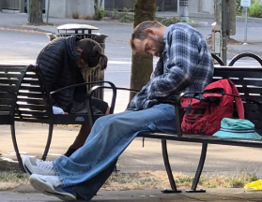
Human misery everywhere.

Slide 12

Instead, the mayor jeopardizes livability and safety -- and wastes tax dollars on programs with zero accountability and poor results.
WHY put homeless services in dense neighborhoods?
The mayor argues that “services must be brought to the people.”
Other leaders argue that “recovery is greatly facilitated by placing vulnerable persons in environments conducive to recovery and away from negative influences such as drug dealing.”
Notes:
---
The Pearl District has undergone significant transformation from its industrial roots to a vibrant urban neighborhood. This development has not only changed the landscape but also created challenges in addressing homelessness and social issues.
Image source: Microsoft 365 content library

Slide 13

Measuring and Accounting for Success
We asked Shelter Services and Salvation Army (Northrup) and TPI (RDNC) about the percentage of people that were helped to the next step of recovery; they were unable to answer.
At Bybee Lakes Hope Center, 87% of participants are successfully navigated and do not return to the streets.
Notes:
---
Identifying cost-effective strategies for homelessness is crucial in ensuring that funds are utilized efficiently. This slide will highlight approaches that have proven to be successful and financially sustainable.
Image source: Microsoft 365 content library

Slide 14
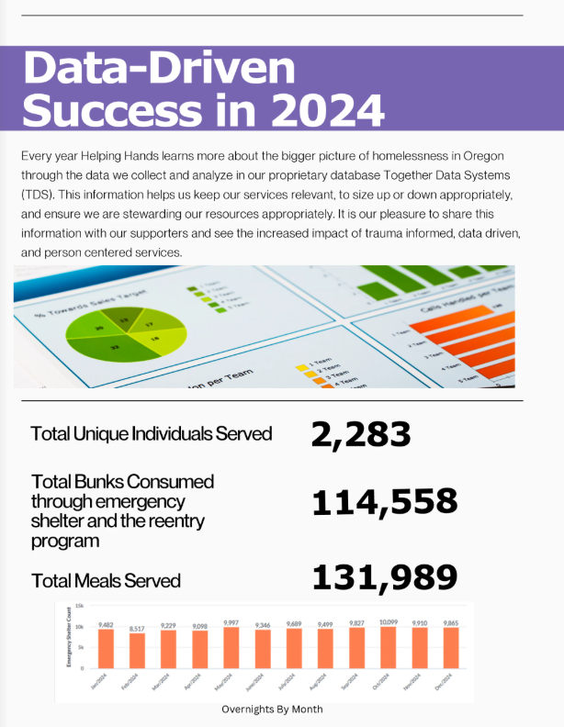
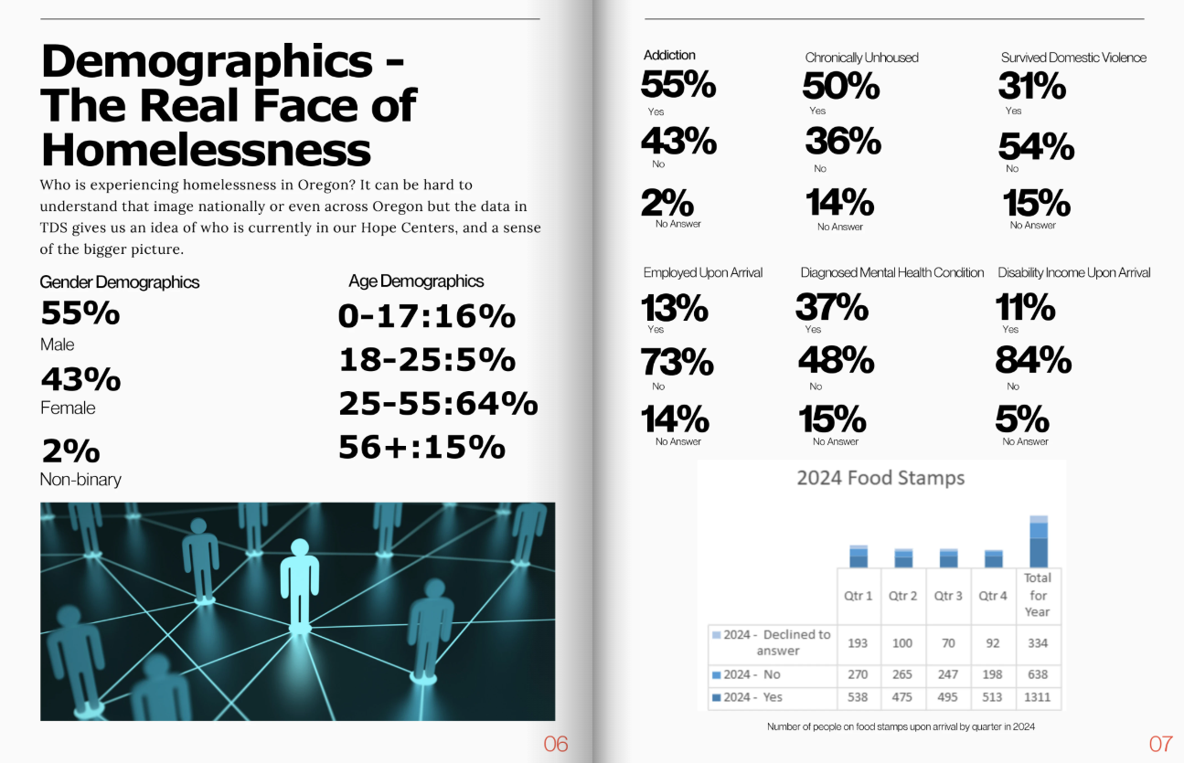

Do the Other Shelters Track and Share Data Like This? (Bybee Lakes Hope Center)
Notes:
---
Identifying cost-effective strategies for homelessness is crucial in ensuring that funds are utilized efficiently. This slide will highlight approaches that have proven to be successful and financially sustainable.
Image source: Microsoft 365 content library

Slide 15
Relocate shelters from residential neighborhoods and ONLY fund programs/operators that have proven, data-driven track records of success in 1) truly helping the homeless turn their lives around, 2) stewarding the public funds in a wise manner.
Re-orient our council to fund the police so that they can enforce drug laws and trespassing – cleaning up our neighborhoods.
Make the county do its job to provide pro-active street-level outreach, wraparound services, treatment & recovery beds -- and to locate those services outside of residential areas.
Take away the “welcome mat” that is causing the influx of homeless from less permissive states -- 50% of the homeless we interview in the Pearl are recently arrived from other states, because Portland is known for “anything goes.”
New Leadership Must Embrace these Priorities to STOP Portland’s Downward Spiral
Notes:
---
The Pearl District has undergone significant transformation from its industrial roots to a vibrant urban neighborhood. This development has not only changed the landscape but also created challenges in addressing homelessness and social issues.
Image source: Microsoft 365 content library

